Slide 1

8
Managing Risk

Slide 2
Chapter Concepts
Identifying risks and their potential impact
Assessing the likelihood of occurrence and degree of impact of risks
Risk response planning
Monitoring risks

Slide 3
Learning Outcomes
Discuss what is involved in managing risks
Identify and categorize risks
Assess and prioritize risks
Prepare a risk response plan
Develop a risk assessment matrix
Monitor risks

Slide 4
Project Risk Management
Project Management Knowledge Areas from PMBOK® Guide

Slide 5
Identify Risks
Can jeopardize accomplishing the project objective
Brainstorm sources of risks
Establish categories for risks and evaluate
Use historical information
Progressively elaborate and identify new risks as more information becomes available

Slide 6
Assess Risks
Determine the likelihood the risk event will occur
Evaluate degree of impact on the project objective
Prioritize
  Likelihood of occurrence and degree of impact
  Position relative to the critical path

Slide 7
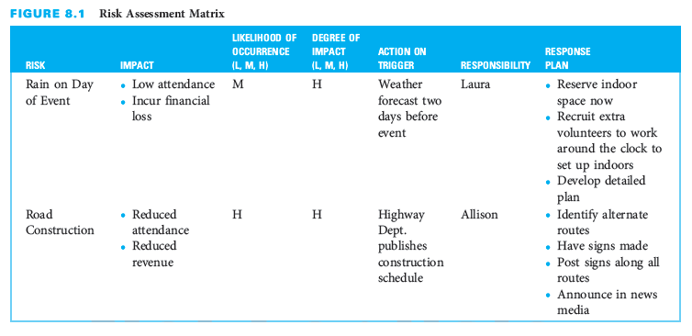
Risk Assessment Matrix

Slide 8
Plan Risk Responses
Set of actions
  Prevent or reduce the likelihood of occurrence or the impact of a risk
  Implement if the risk event occurs
Establishes a trigger point for implementing an action
Assigns responsibility for implementation
Avoid, mitigate, or accept the risk
Include a contingency fund to cover implementation cost

Slide 9
Managing Risks for Information Systems Development
Risks can be categorized into seven types
  Technological risk
  Human risk
  Usability risk
  Project team risk
  Project risk
  Organizational risk
  Strategic and political risk

Slide 10
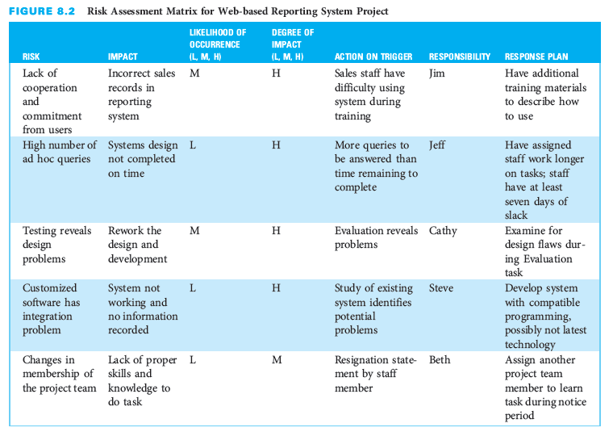
IS Example: Risk Assessment Matrix

Slide 11
Critical Success Factors
Identify risks and their potential impacts before the project starts.
Involve the project team or experts in assessing risks.
Assign high priority to managing risks that have a high likelihood of occurrence and a high potential impact on the project outcome.
Develop response plans for addressing high priority risks.

Slide 12
Summary
Risk is an uncertain event that, if it occurs, can jeopardize accomplishing the project objective.
Risk management includes identification, assessment, monitoring, and response to project risks in order to minimize the likelihood of occurrence and/or the potential impact of adverse events on the accomplishment of the project objective.
Risk identification includes determining which risks may adversely affect the project objective and estimating what the potential impacts of each risk might be if it occurs.
Assessing each risk involves determining the likelihood that the risk event will occur and the degree of impact the event will have on the project objective, and then prioritizing the risks.
A risk response plan is a defined set of actions to prevent or reduce the likelihood of occurrence or the impact of a risk, or to implement if the risk event occurs.
Regularly review and evaluate all risks to determine if there are any changes to the likelihood of occurrence or the potential impact of any of the risks, or if any new risks have been identified.

